Slide 1


QCD Closure Tests 2016, 2017, 2018
George Bakas, Ioannis Papakrivopoulos

Slide 2
QCD Closure Tests
We have identified a problem regarding the shape of the QCD closure in 2017 and 2018 using the working points that we decided to work with (2017: 0.0 and 2018:0.1)
In these slides we show the different results using different WP’s in order to investigate whether the shape is inconsistent due to topTagger working points
Closure tests and tt contamination for jetMassSoftDrop (leading jetPt) variable
2017 Data production
Subdominant background production for mass fit

Slide 3
Overview
Efficiencies and Acceptance for mTT and jetPt variables
Selection:
Jet Matching
Parton cuts:
partonPt[0],[1] > 400
|partonEta[0],[1]| < 2.4
mTTbarParton > 1000
Reco cuts:
nJets > 1
nLeptons = 0
mJJ > 1000
jetPt[0],[1] > 400
|jetEta[0],[1]| < 2.4
bTagging cut (mediugm WP deepCSV) (2016: 0.6321, 2017: 0.4941, 2018: 0.4184)
Tagger cut (top Tagger) (2016: 0.2, 2017:0.0, 2018: 0.1)
JetMassSoftDrop > 120 GeV and < 220 GeV
TriggerBit

Slide 4
Purpose of this presentation
The QCD closure tests show the shape comparison between 3 regions
Signal Region (SR): all cuts shown before + 2btagged jets
Control Region (CR): same cuts as SR but btag cut is reverted (0 btag jets)
1bTag region: same cuts as SR but only 1 jet needs to be btagged
Control Region Contamination: Shows the percentage of the ttbar signal that passes the Control region cuts
For each year, different topTagger cut Working points + btag WP’s
QCD Closure Tests + ttbar CR contamination for variables:
mJJ: [1000, 1200, 1400, 1600, 1800, 2000, 2400, 2800, 3200, 4000, 5000]
ptJJ: [0,60,150,300,450,600,750,950,1100,1300]
yJJ: [-2.4,-1.5,-1.0,-0.5,0.0,0.5,1.0,1.5,2.4]
Leading and subleading jetPt: [400,450,500,570,650,750,850,950,1100,1300,1500]
Leading and subleading |jetY|: [0.0,0.2,0.4,0.6,0.8,1.0,1.2,1.4,1.6,1.8,2.0,2.2,2.4]

Slide 5
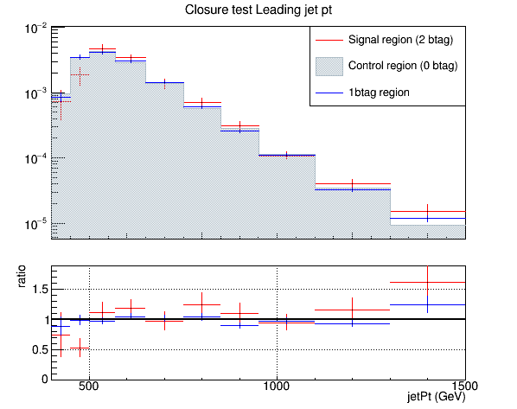
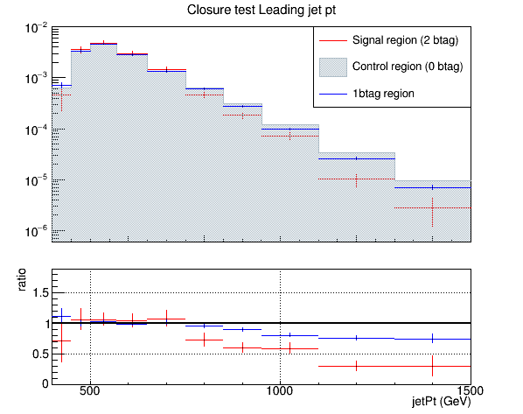
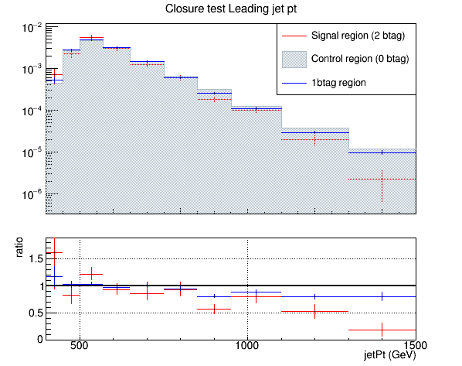
QCD Closure Tests ’16, ‘17, ’18 jetPt0
2016 topTagger 0.2, deepCSV
2017 topTagger 0.0, deepCSV
2018 topTagger 0.1, deepCSV

Slide 6

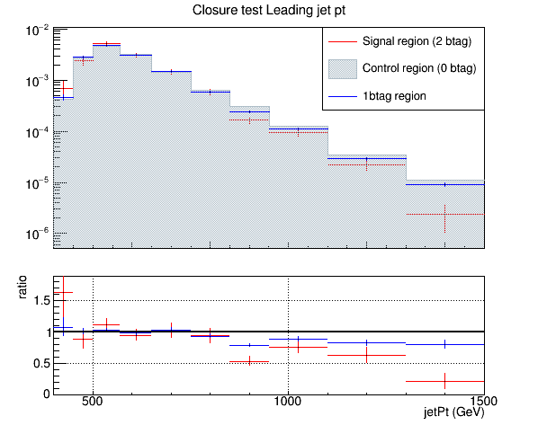
QCD Closure Tests ’16, ‘17, ’18 jetPt0
topTagger 0.0, deepCSV

Slide 7

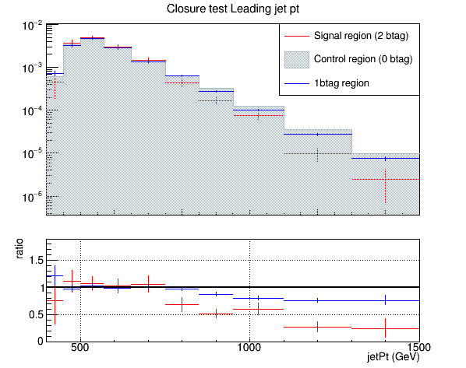
QCD Closure Tests ’16, ‘17, ’18 jetPt0
topTagger 0.1, deepCSV

Slide 8

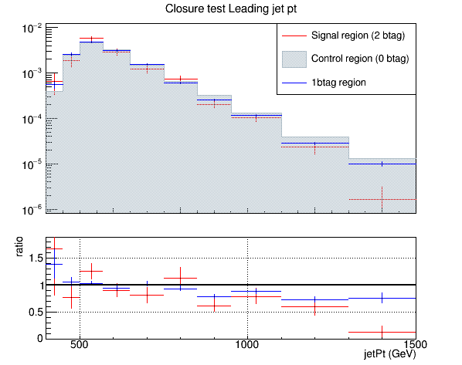
QCD Closure Tests ’16, ‘17, ’18 jetPt0
topTagger 0.2, deepCSV

Slide 9

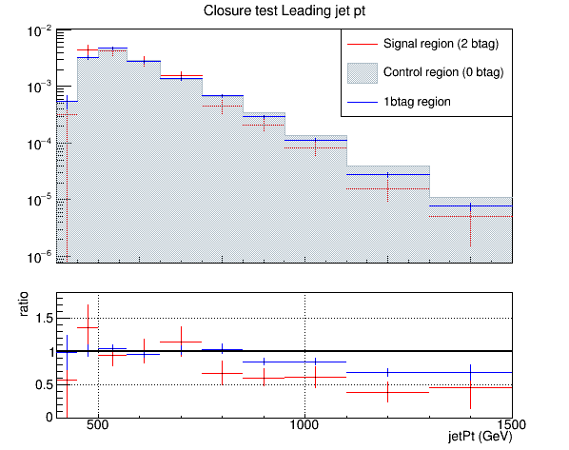
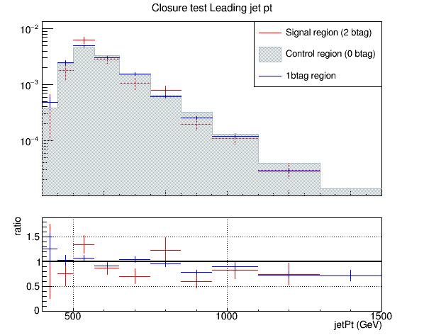
QCD Closure Tests ’16, ‘17, ’18 jetPt0
topTagger 0.3, deepCSV

Slide 10
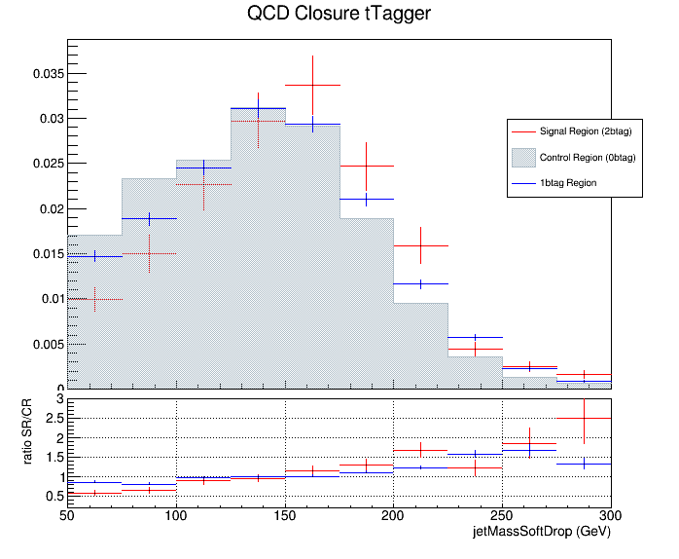
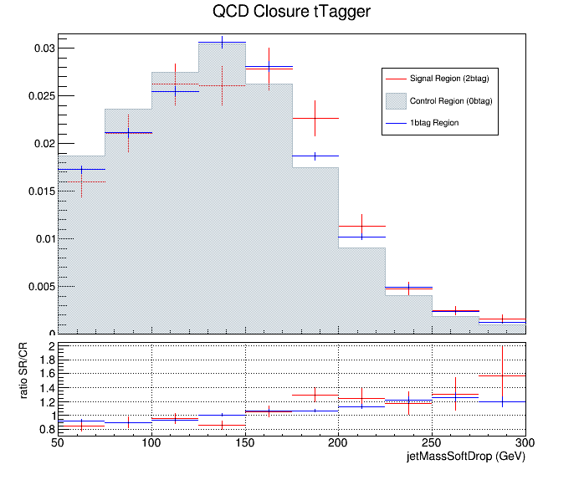
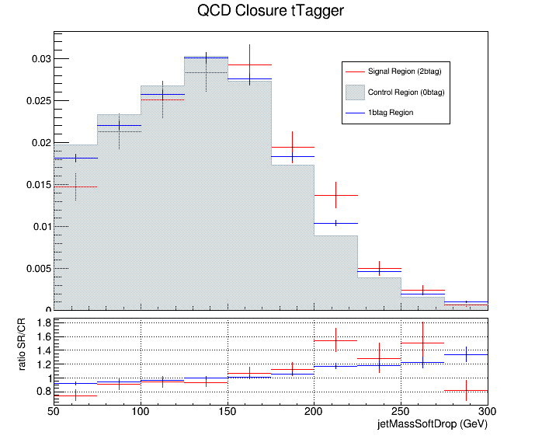
QCD Closure Tests ’16, ‘17, ’18 jetPt0
jetMassSoftDrop (leading jet)
2016
2017
2018

Slide 11
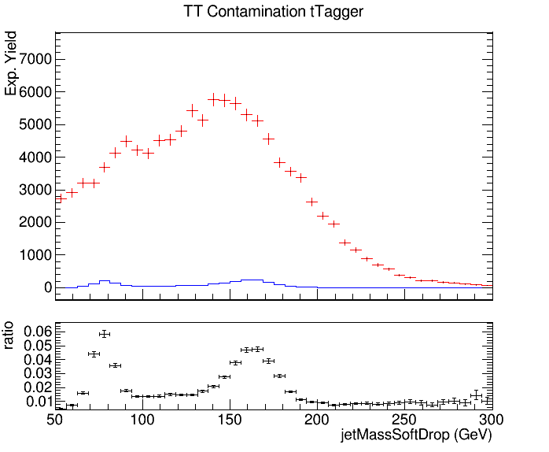
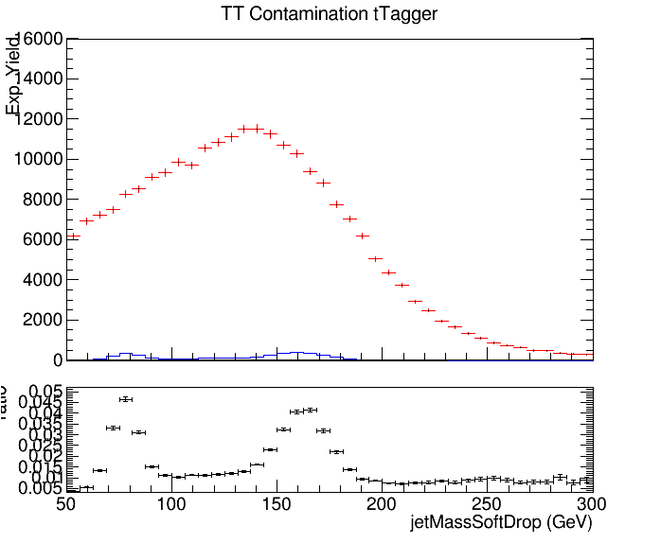
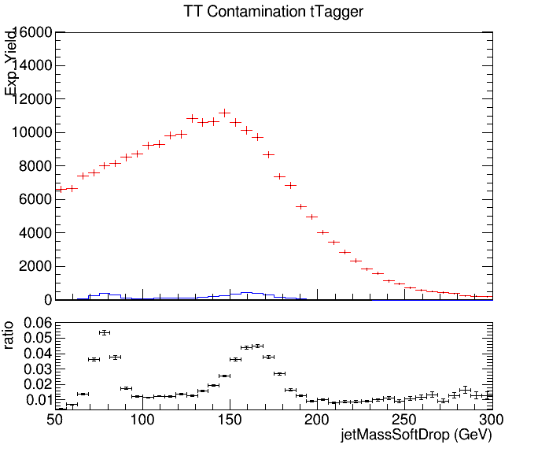
QCD Closure Tests ’16, ‘17, ’18 jetPt0
jetMassSoftDrop (leading jet)
2016
2017
2018

